Slide 1

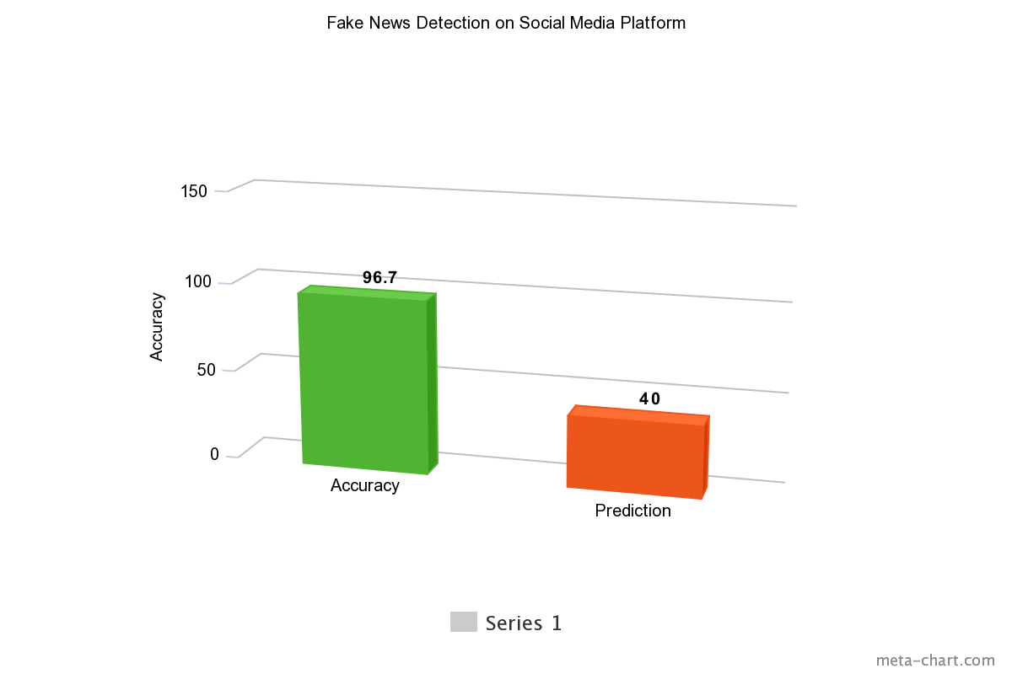
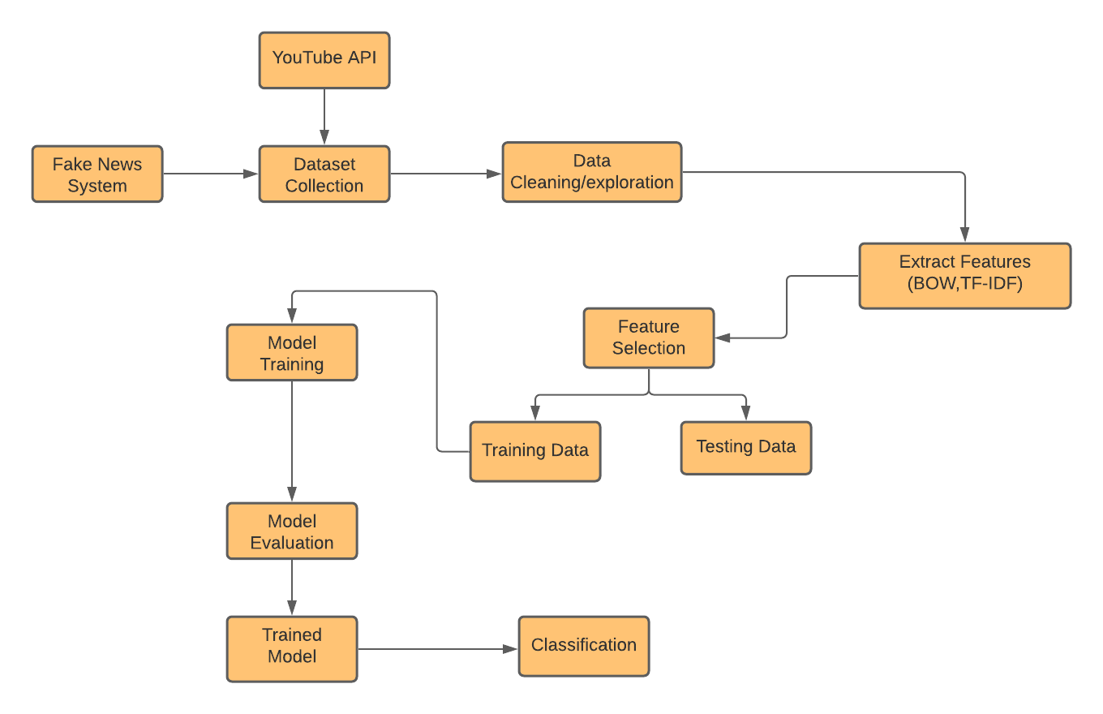
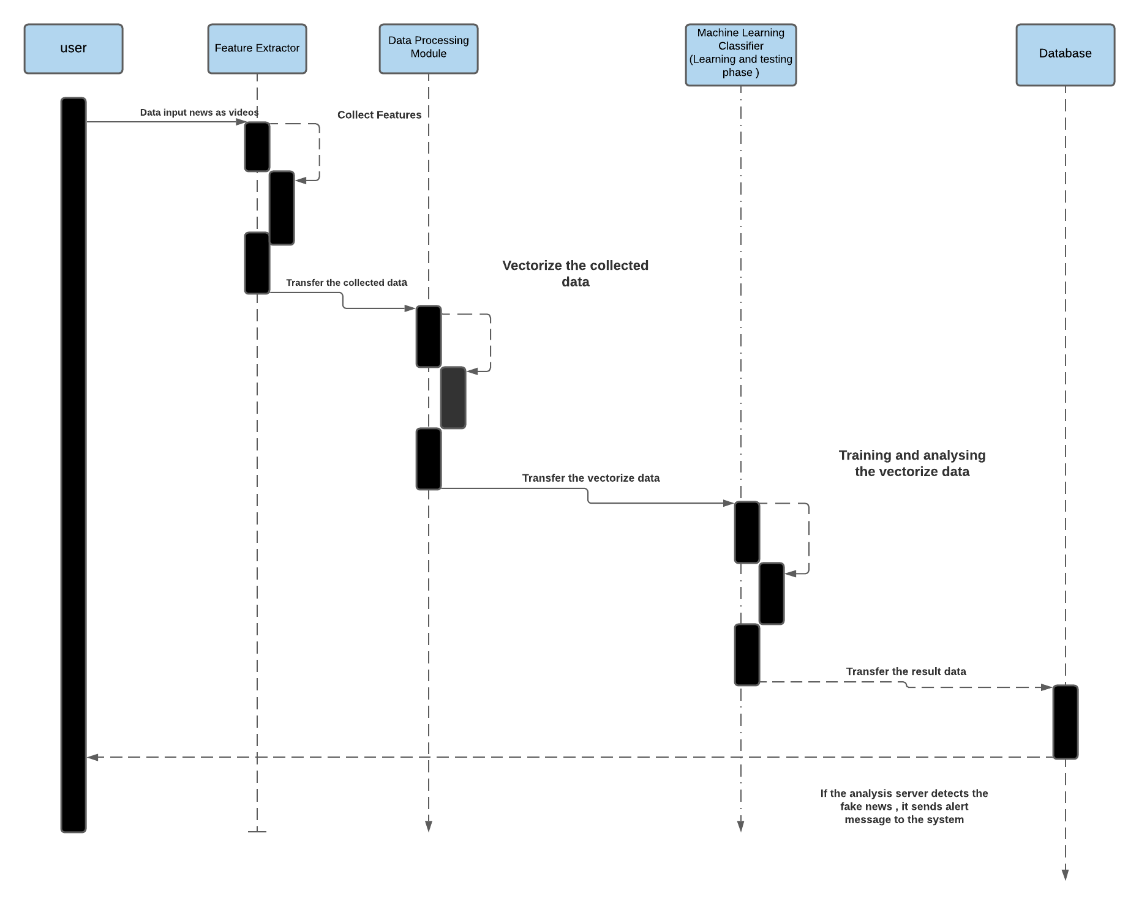
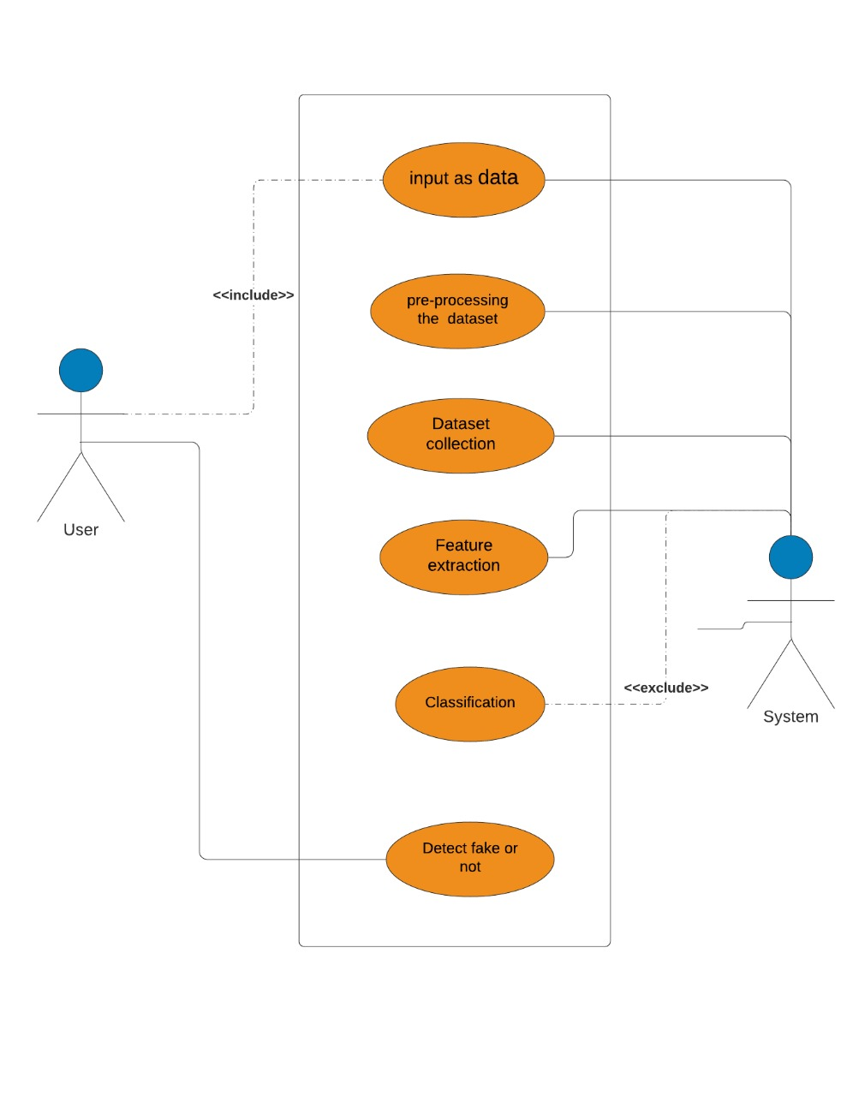
FAKE NEWS DETECTION SYSTEM ON SOCIAL MEDIA PLATFORM MARYAM MUNIR - 180978,QURAT UL AIN - 181030 SUPERVISOR:SIR SHOAIB MALIK FYP ID :- ID-123
Introduction
Flow Diagram
Results
News currently spreads rapidly through the internet. Because fake news stories are designed to attract readers, they tend to spread faster. For most readers, detecting fake news can be challenging and such readers usually end up believing that the fake news story is fact. Because fake news can be socially problematic, a model that automatically detects such fake news is required.
In our proposed framework, as illustrated below, we are expanding on the current literature by introducing different techniques with various feature sets to classify news articles from multiple domains as true or fake. The ensemble techniques along with Word Count Based Models feature set used in this research are the novelty of our proposed approach.
Problem Statement
The increasingly rapid pace of spreading fake news is considered a problem in conjunction with the increasing number of people who are relying upon social media to get news.
That earns widespread attention from research communities due to the negative impact and influence of fake news on public decisions.
The project aims to illuminate the current research on fake news problem and the process of detecting fake news using deep learning approaches.
The results of the research paper were 96% accurate and model was trained according to their own dataset but our accuracy was 40% because our dataset was a little bit different. After training the models, we got 40% prediction because we had just implemented a single module of that project and here are the above results.
Goals/Objectives
Our goal is to design a system that will detect the fake news by taking videos as input and will give the output as fake or authentic. We are trying to compare the audio with the header text in YouTube videos to detect them whether they are fake or not by using the different deep learning models.
Our Main objective is to publish a research paper on this topic if we get the accurate results and if we were not able to the get the accurate results then we will just re-implement the specific research paper.
Prototype
Discussion / Comparisons
The advent of the World Wide Web and the rapid adoption of social media platforms (such as Facebook, Twitter and YouTube) paved the way for information dissemination that has never been witnessed in the human history before. These platforms not only benefit us but also used with a negative perspective by certain entities commonly for monetary gain and there has been a rapid increase in the spread of fake news in the last decade, most prominently observed in the 2016 US elections. Such proliferation of sharing articles online that do not conform to facts has led to many problems not just limited to politics but covering various other domains such as sports, health, and also science. For solving that problem we started learning about different machine learning models to make a system that will help us to detect the news. We are studying and doing research on word count based models to work on text to text detection using FNC-1 dataset but to check videos to text, we will be using LSTM and Bi-LSTM models by creating our own dataset.
Use Case Diagram
Conclusion / Future Work
In conclusion, we would like to share that if we get the maximum accuracy then we will be publishing our own research paper on fake news detection system on social media platform and we will try to continue this project in our MS studies and will do some improvements in the previous work.

